Slide 1


Slide 2
EOSC - advancing Open Science to the next level
Karel Luyben
President EOSC Association
We accelerate Open Science
12 June 2023, Brussels

Slide 3

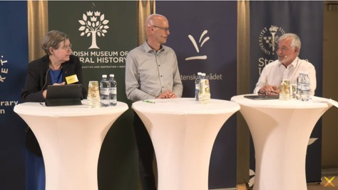


Open Science on Top of Council Agenda
The Swedish EU Council Presidency

Slide 4

Science in transition
The Open Science paradigm affects the whole research cycle and all its stakeholders
It implies sharing knowledge and tools:
as early as possible in the research process;
as openly as possible;
as FAIR as possible;
not only within a discipline but also between disciplines and society at large.

Slide 5
Open Science
towards open access
“science
as is”
“science as
will be”
towards FAIR data
embedding citizen science
recognition
& rewards
support
& training
community
engagement
infra-
structures
policies
& regulations
ENGAGEMENT, COORDINATION AND SUPPORT

Slide 6


“A web of scientific insight”
Web of FAIR Data and related Services
Federation of relevant existing and future data sources
Virtual space where science producers and consumers come together
An open-ended range of content and services
Based on the FAIR principles
Meeting all European data requirements
In interaction with other regions of the world

Slide 7
EOSC – additionality to the web of FAIR data
EUROPEAN OPEN SCIENCE CLOUD
WEB OF FAIR DATA
WORLD WIDE WEB
INTERNET
NETWORKS
COMPUTERS
Modelled after: World Wide Web - Wikipedia

Slide 8
Guiding principles for EOSC
The overarching principle for developing EOSC is that research has to be at the centre of the EOSC initiative.
Multi-stakeholderism
EOSC will succeed if and only if it follows a multi-stakeholder approach;
Openness
EOSC will ensure research artefacts be ‘as open as possible, as restricted as necessary’;
FAIR principles
EOSC research artefacts need to be findable, accessible, interoperable and reusable;
Federation of infrastructures
EOSC will federate existing and upcoming data- and e-infrastructures;
Machine-actionable
EOSC will ensure that machines can find, access and interoperate on data helping people in servicing the needs of European scientists.

Slide 9
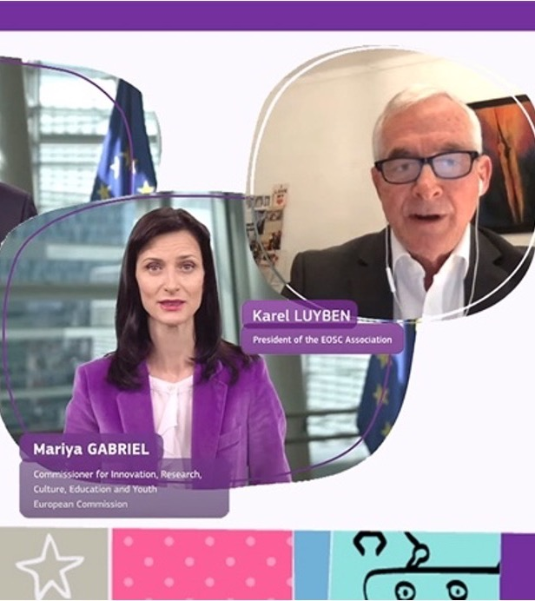
Horizon Europe co-programmed
EOSC Partnership
Launched June 2021
One billion euros commitment by the European Union and the EOSC Association

Slide 10
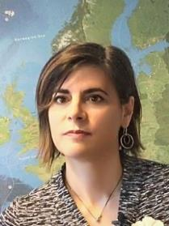

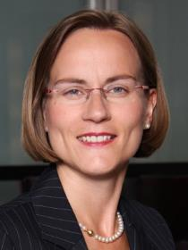

European Open Science Cloud Partnership
EOSC STEERING BOARD
EOSC ASSOCIATION
MoU
Partnership
Board
European Commission
DG-RTD
DG-CNECT
Anna Panagopoulou
President
Karel Luyben
Secretary General
Ute Gunsenheimer
MS/AC collective representation
BOARD
Member States and Associated Countries
General Assembly
(including organisations performing research, funding research, providing services, organisations mandated by MS/AC and other organisations)
Exchange of information
Volker Beckmann

Slide 11
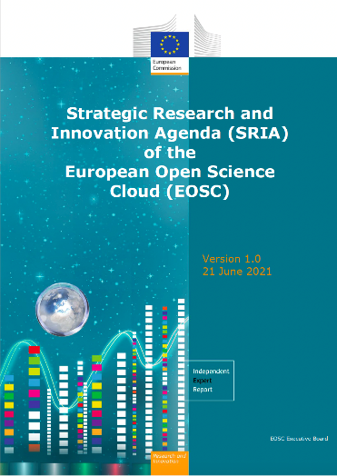
SRIA and MAR
Strategic Research and Innovation Agenda
Open Science practices and skills are rewarded and taught, becoming the ‘new normal’
Multi-annual roadmap sets priority activities and outcomes grouped by three implementation levels – European, National, Institutional
Three phases of MAR
  2021-2022: development towards a functional federation of infrastructure
  2023-2024: expansion to production that generates added value
  2025-2027: expansion to develop impact from Open Science
Standards, tools and services allow researchers to find, access, reuse and combine results
Sustainable and federated infrastructures enable open sharing of scientific results

Slide 12
What do we concretely aim for?
● Research data produced by publicly funded research in Europe is as FAIR as possible, preferably by design;
● Researchers performing publicly funded research to make relevant results available, as openly as possible;
● Professional data stewards to be available in research-performing organisations in Europe to support RDM for Open Science;
● The EOSC Interoperability Framework supporting a wide range of FAIR digital objects including data, software and other research artefacts;
● EOSC (version x) is operational and provides a stable infrastructure, supporting the research process and helping to address societal challenges;
● EOSC Federation to be populated with a valuable corpus of interoperable data;
● The scope of EOSC is widened to serve the public and private sectors;
● EOSC to become a valuable and valued resource to a wide range of users from the research and education, public and private sectors (including for-profit).

Slide 13
Where do we stand?
● After an initial period of many projects without much convergence (2015-2020) we have to see that we get our aims sufficiently developed in the present period of convergence (2021-2026).
● For this it is essential that we get a Minimal Viable EOSC (MVE / EOSC-EU-node) operational asap and as good as possible aligned with work done by all the relevant communities (European, National and Institutional).

Slide 14

Tasks for EOSC Association to see to:
Outreach to stakeholders
Manage the ‘EOSC’ trademark(s)
Monitor additional activities and KPI
Contribute to Horizon Europe ERA Actions
Further develop and govern the EOSC-EU-node
Manage the AAI
Manage PID policies
Manage an Interoperabilty Framework
Manage the compliance framework
Tasks for EOSC Association to see to:

Slide 15


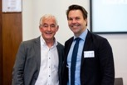


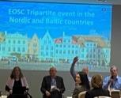




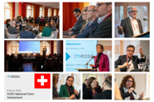
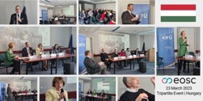
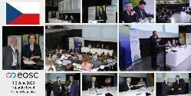
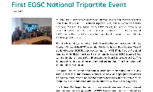

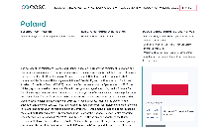
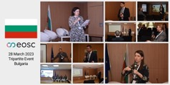
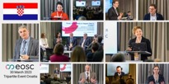
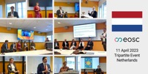
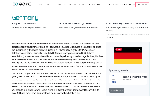
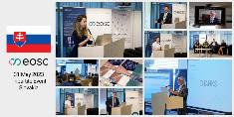
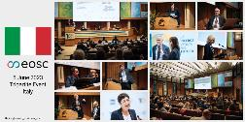
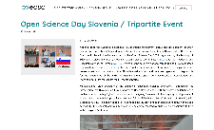

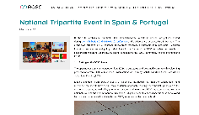

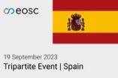
2022
1293
Participants
National Tripartite Events
177
Speakers & moderators
  24 countries targeted in NTE
  2101 participants in National and NTE
  + 35 preparatory meetings
  31 country pages
  15 Articles
  7 Post event reports
  Social media coverage
16
Countries targeted
March – June 5th 2023
808
8
Participants
Countries targeted
COUNTRY PAGES - SECTIONS:
EOSC representatives
OS in the country
Coordination structures
Policies
Practices & Use Cases
UPCOMING TRIPARTITE EVENTS (June - September 2023)

Slide 16
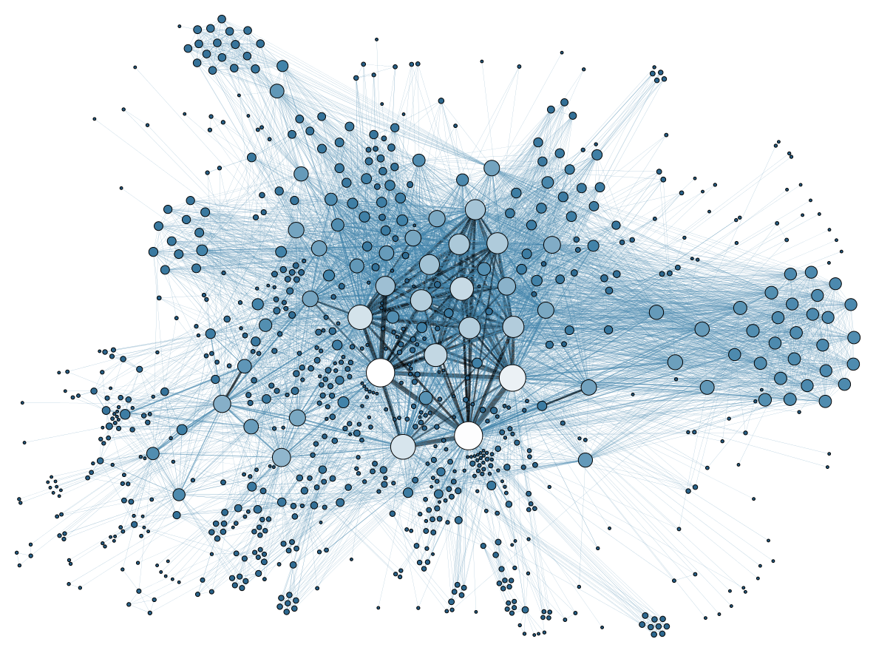
Outlook to the future

Slide 17

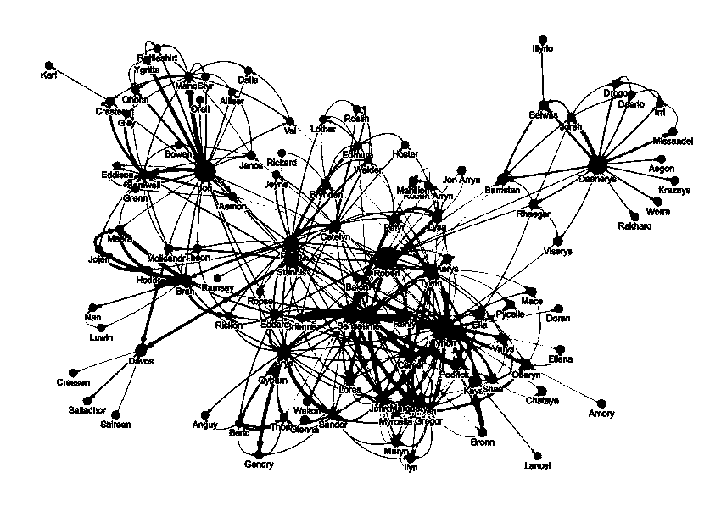

Slide 18
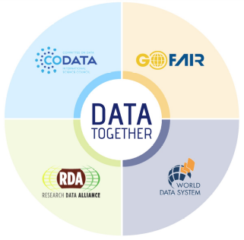




EOSC on a global stage
EOSC Association works with other regional initiatives towards common goals for Open Science, driving global convergence on standards in support of the implementation of an open science commons
EOSC Association has involvement in GORC, GOSC and OSCER
Service providers from third countries will be able to participate in EOSC, if they adhere to the EOSC Rules of Participation and applicable legislation

Slide 19
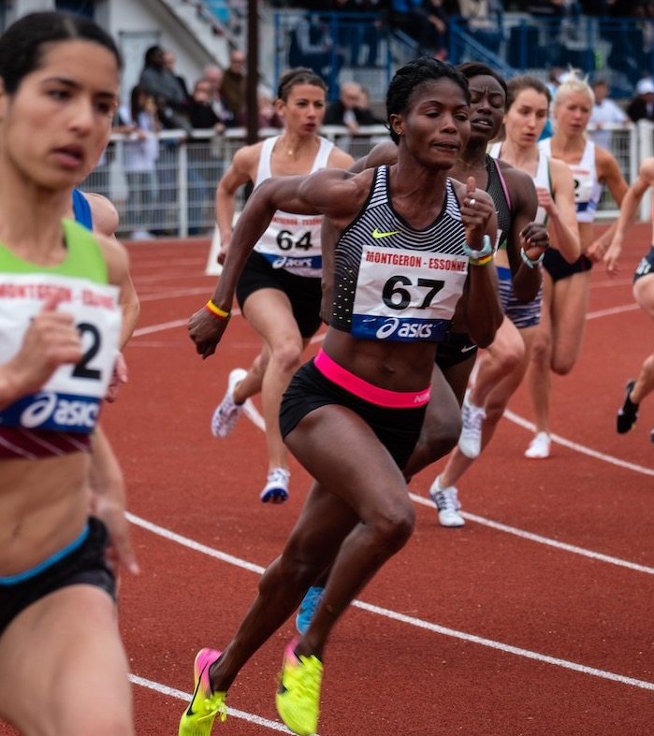
Getting ahead of the curve and advancing to the next level, means:
Take advantage of ongoing EU and national policy making
Understand the evolving objectives of the funders of this transition
Realise that FAIR is the most important requirement;
Educate staff and ‘train the trainer’;
Create ‘Data/Digital Competence Centres’;
Connect to other relevant initiatives at domain-specific levels as well as on the national level
Join this powerful movement to make
Open Science the new normal

Slide 20
THANKS

Slide 21
Ten things EOSC is not …
… a cloud infrastructure
… synonymous to Open Science
… the EOSC Portal
… the EOSC Association
… a new research data repository or data management system
… owning the data it will help to provide access to
… a new pan-European e-infrastructure
… substitution of any existing data- or (e-)infrastructures
… directly for individual researchers, but it is for research
… in competition with anything or anybody

Slide 22
EOSC vision in a nutshell
EOSC is the European web of FAIR data and related services for research
Research data that is easy to find, access, interoperate and reuse (FAIR)
Trusted and sustainable research outputs are available within and across scientific disciplines
What
Unlock the full potential of research data to accelerate discoveries and innovation
Why
Enabling the definition of standards, and the development of tools and services, to allow researchers to find, access, reuse and combine results
Establishing a sustainable and federated infrastructure enabling open sharing of scientific results
Ensuring that Open Science practices and skills are rewarded and taught, becoming the ‘new normal’
How
As described in the Strategic Research and Innovation Agenda (SRIA)

Slide 23
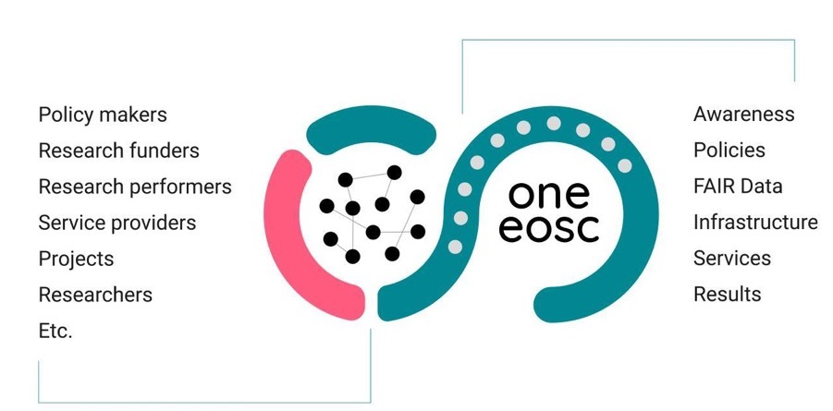
Steering Coordination to Leverage the Ecosystem
Stakeholder Engagement

Slide 24

Broadcasting the Voice of the Community

Slide 25
Tasks on the way to create EOSC
Operational and development tasks in discussion with the EC
Deploying and operating the EOSC EU node
(Core, Exchange, FAIR Data Federation)
Maintaining and updating the EOSC EU node and expanding the EOSC federation
(with elements that are close to the ‘market’)
Enabling a ‘web of FAIR data and services’ for science
Develop, prototype and test new elements supporting the evolution of the EOSC Core and Exchange and the tools enabling the federation
(focus on elements that can be made ready for the ‘market’)
Enabling Open Science policies and the uptake of Open Science practices

Slide 26
OPEN DATA and/or FAIR DATA
FAIR
Findable
Accessible
Interoperable
Reusable
OPEN
DATA
FAIR
DATA
FAIR OPEN
DATA
Towards “as FAIR as possible” and “as open as possible”

Slide 27



Twinning EOSC and the e-infrastructures
EOSC is to be an infrastructure and could be seen as a twin sister (or brother) of the European e-infrastructure organisations.
e-infra-
structures
e-infra-
structures
The last offering the store, compute and connect services used by EOSC to offer the servicing of data and creating interoperability.
The combination forms the EOSC-ecosystem (yin / yang).

Slide 28
Important requirements for EOSC to deliver
Relevant data
Sufficiently rich metadata
Search mechanism
Software (often self made)
Compute power (usually available)
Storage (usually available)
Access
Automatic referencing
……….

Slide 29
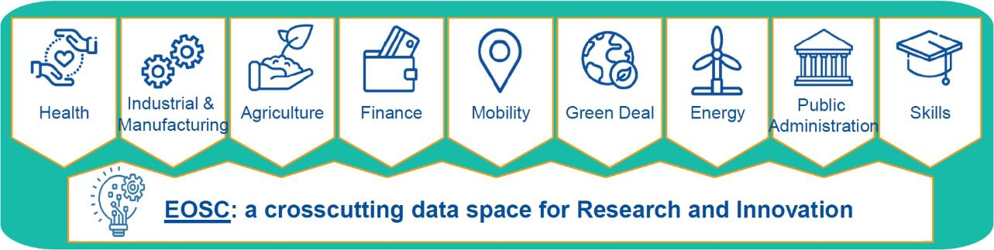
Position of EOSC according to the European Commission
Taken from EC slides
“EOSC is the basis for a science, research and innovation data space that will bring together data resulting from research and deployment programmes and will be connected and articulated with the sectoral data spaces”
(European Data Strategy, COM(2020) 66 final)

Slide 30
EOSC ‘helicopter view’
EOSC-SB meeting #16, Stockholm, 26 April 2023,
and 24 May 2023 Tripartite event on EOSC post-2027
Slide from M. Schouppe (EC)
Main EOSC tasks for the future | Today (co-programmed partnership) | In the future?
Task 1: Deploying and operating the EOSC EU node (Core, Exchange, FAIR Data Federation) | EC procurement « EOSC managed services » | EC Entrusts another legal entity with budget implementation tasks, possibly in the context of a European partnership? or Continues to manage directly grants and procurement actions, possibly in the context of a European partnership? What about combining these two approaches (depending on the tasks)? What would be the right balance between procurement and grants? (Irrespective of who is the granting / contracting authority)
Task 2: Maintaining and updating the EOSC EU node and expanding the EOSC federation (with elements that are close to the ‘market’) | N/A
Task 3: Enabling a ‘web of FAIR data and services’ for science | EU grants across HE National & institutional additional activities
Task 4: Develop, prototype and test new elements supporting the evolution of the EOSC Core and Exchange and the tools enabling the federation (elements that can be made ready for the ‘market’) | EC grants resulting from Calls defined in the RI Work Programme
Task 5: Enabling Open Science policies and the uptake of Open Science practices | Tripartite activities (including with EU grants)

Slide 31
Horizon Europe Work Programme
From Sep 2022 DRAFT “HE Research Infrastructure Work Programme 2023-2024”
INFRA-2023-EOSC-01 | Type of Action | New Budget in MEUR | Old Budget in MEUR
Build on the science cluster approach to ensure the uptake of EOSC by research infrastructures and research communities | RIA | 25.00 | 24.00
Development of community-based approaches for ensuring and improving the quality of scientific software and code | RIA | 8.00 | 8.00
Planning, tracking, and assessing scientific knowledge production | RIA | 8.00 | 10.00
Next generation services for operational and sustainable EOSC Core Infrastructure | RIA | 10.00 | 10.00
EOSC Architecture and Interoperability Framework | CSA | 3.00 | 4.00
Trusted environments for sensitive data management in EOSC | RIA | 15.00 | 8.00
Total Budget |  | 69.00 | 64.00
= MAR 2023-2024 related
“Old Budget”
from March 2022

Slide 32
Horizon Europe Work Programme
From Sep 2022 DRAFT “HE Research Infrastructure Work Programme 2023-2024”
INFRA-2024-EOSC-01 | Type of Action | New Budget in MEUR | Old Budget in MEUR
FAIR and open data sharing in support of the mission adaptation to climate change | RIA | 16.00 | 8.00
Supporting the EOSC Partnership in further consolidating the coordination and sustainability of the EOSC ecosystem | CSA | 4.00 | 3.00
Enabling a network of EOSC federated and trustworthy repositories and enhancing the framework of generic and discipline specific services for data and other research digital objects | CSA | 5.00 | 5.00
Long-term access and preservation infrastructure development for EOSC, including data quality aspects | RIA | 8.00 | 8.00
Innovative and customizable services for EOSC Exchange | RIA | 28.00 | 7.00
Total Budget |  | 61.00 | 31.00
= MAR 2023-2024 related
“Old Budget”
from March 2022

