Slide 1





















AquaINFRA
In a Nutshell
The AquaINFRA project started 1st January 2023 and will run over 4 years
The budget is 7.6 million € plus about 300,000 £ paid by UK Government to our UK partner
The project coordinator is Aalborg University represented by professor Henning Sten Hansen
The consortium consists of 19 regular partners and 3 associated partner including one from UK

Slide 2
Key Contributions to EOSC SRIA
Contribution of AquaINFRA
Description of the contribution of the project to the Strategic and Operational objectives of the SRIA and its Action Areas (A selection, no detailed description of all work packages needed).
AquaINFRA will contribute to New ways of Science by our focus on disseminating EOSC and the FAIR principles to researchers within ocean- and freshwater sciences as well as related social sciences
AquaINFRA will contribute to Boundary Conditions by arranging training courses on EOSC and FAIR principles
AquaINFRA will contribute to Expected Impacts by developing a data infrastructure supporting seamless integration of ocean- and inland water data together with associated social science data. In addition, several case studies involving as well natural scientist and social scientist will stimulate the understanding of EOSC and FAIR

Slide 3
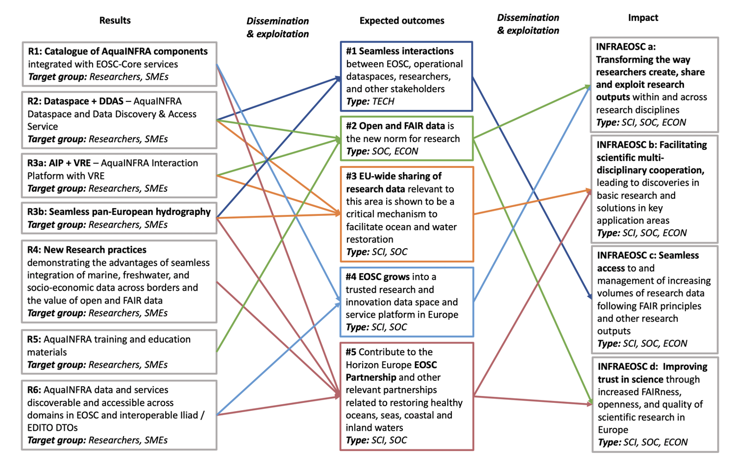
Key Impacts and deliverables

Slide 4
Dependencies and Collaborations
AquaINFRA
Dependencies on other projects/initiatives (if any) and collaborations established with other projects/initiatives relevant for the development of the EOSC
The success of AquaINFRA is not directly dependant on the results from other EOSC related projects
….. but results from EOSC projects like EOSC Future, DICE, and FAIRCORE4EOSC will certainly be connected to AquaINFRA by common partnerships with these projects
The AquaINFRA project has a initiated a collaboration with BlueCloud 2026 by having a meeting on 15th March 2023
We have meetings with other projects like Marco Bolo and Obama-Next and we will introduce the partners to EOSC and FAIR principles through a workshop
We have established collaboration with the ILIAD Digital Twin of Ocean

Slide 5
Your vision
AquaINFRA
Our Vision is that (all) research are available to all researchers through common Data Discovery and Access Systems and here the Digital Twins of the Earth are key elements
Having all researches to analyse on all available data is more efficient than having each researcher only analysing their own private data
And this is crucial to solve the big global challenges
However, we have huge challenges convincing the European research community about the the advantages of a real implementation of the FAIR principles
EOSC and EOSC related projects play a key role in this development
Thus. It is important that the emerging Digital Twins relies on the principles of EOSC

