Slide 1

CRAFT-OA
CREATING A ROBUST ACCESSIBLE FEDERATED TECHNOLOGY FOR OPEN ACCESS
Coordination meeting of EOSC-related projects
funded under Horizon Europe
June 15-16, 2023, Brussels
Funded
by the European Union

Slide 2




CRAFT-OA
Creating a Robust Accesible Federated Technology for Open Access
Provide technical improvements for journal platforms and journal software
Build communities of practice to foster overall infrastructure improvement
Increase visibility, discoverability and recognition for Diamond OA publishing
Integrate Diamond OA publishing with EOSC and other large-scale data aggregators
Start 01 Jan 2023
End 31 Dec 2023
Budget of ~5 mill EUR
23 Partners from 14 European countries
(plus affiliated entities)
Göttingen University Library is coordinator on behalf of OPERAS Community
Partner project DIAMAS
(joint advisory board)
Consortium consists of experienced stakeholders and service providers in open science and open access scholarly publishing, especially around institutional Diamond* Open Access, IPSP (institutional publishing service providers)
*Diamond OA: institution-funded publishing infrastructure for open access publications, no author-facing charges)

Slide 3
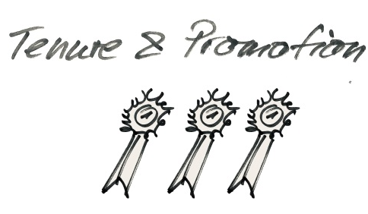
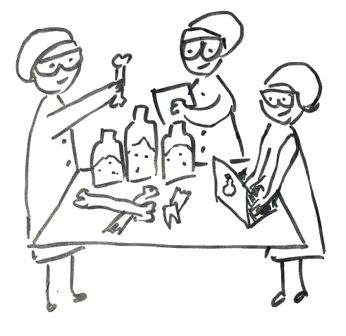
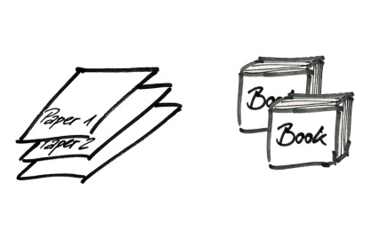
Key Contributions to EOSC SRIA
Contribution of Project CRAFT-OA
Ensure that Open Science practices and skills are rewarded and taught, becoming the ‘new normal’
1
Publishing “done right” is intrinsic to a paradigm shift towards open science
Publishing under institutional governance as the “lab” for bringing open science to the public
Rewards for open science require recognition -> no information loss during publishing -> platforms fit for purpose
Technical maturity as an economy of scale to free potential for research

Slide 4
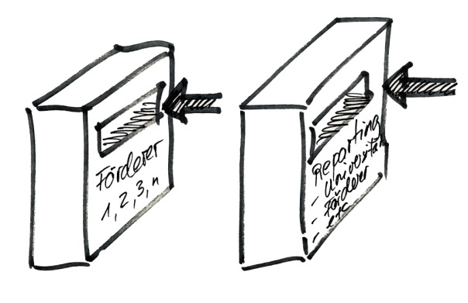
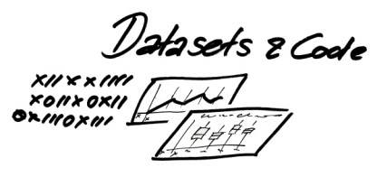

Key Contributions to EOSC SRIA
Contribution of Project CRAFT-OA
Enable definition of standards, deve-lopment of tools & services, to allow researchers to find, access, reuse & combine results
Publishing “done right” enables FAIR
Interoperability of platforms requires standardised and enriched (meta)data
Multilingualism should not be a blocker to mash and reuse
Clear license situation enables reuse
2

Slide 5
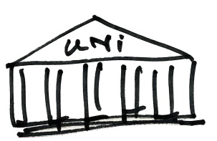
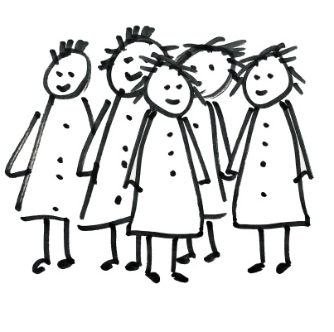
Key Contributions to EOSC SRIA
Contribution of Project CRAFT-OA
Establish a sustainable and federated infrastructure enabling open sharing of scientific results
3
Publishing “done right” enables federated infrastructures and shared knowledge
Science should define the features of its publishing system to bring a cultural shift towards sharing
Technical maturity is prerequisite for federated infrastructures
Technical maturity is prerequisite for sustainability

Slide 6
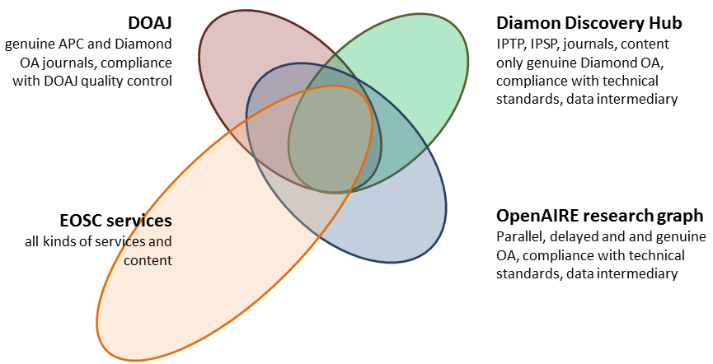
Key impacts and deliverables
Contribution of Project CRAFT-OA
Enabling smaller journals to be indexed in widest range of data aggregations
Clear technical standards as a roadmap for technical maturity, interoperability and sustainability
Living Handbook for journal platform operation
two summer schools for journal managers with reusable curriculum
Building networks of IPSPs
Diamond Discovery Hub to enhance visibility and recognition of Diamond Open Access content, journals, platforms and service provider
Onboarding of Diamond Open Access IPSPs into the EOSC
Building the Diamond Open Access capacity centre

Slide 7
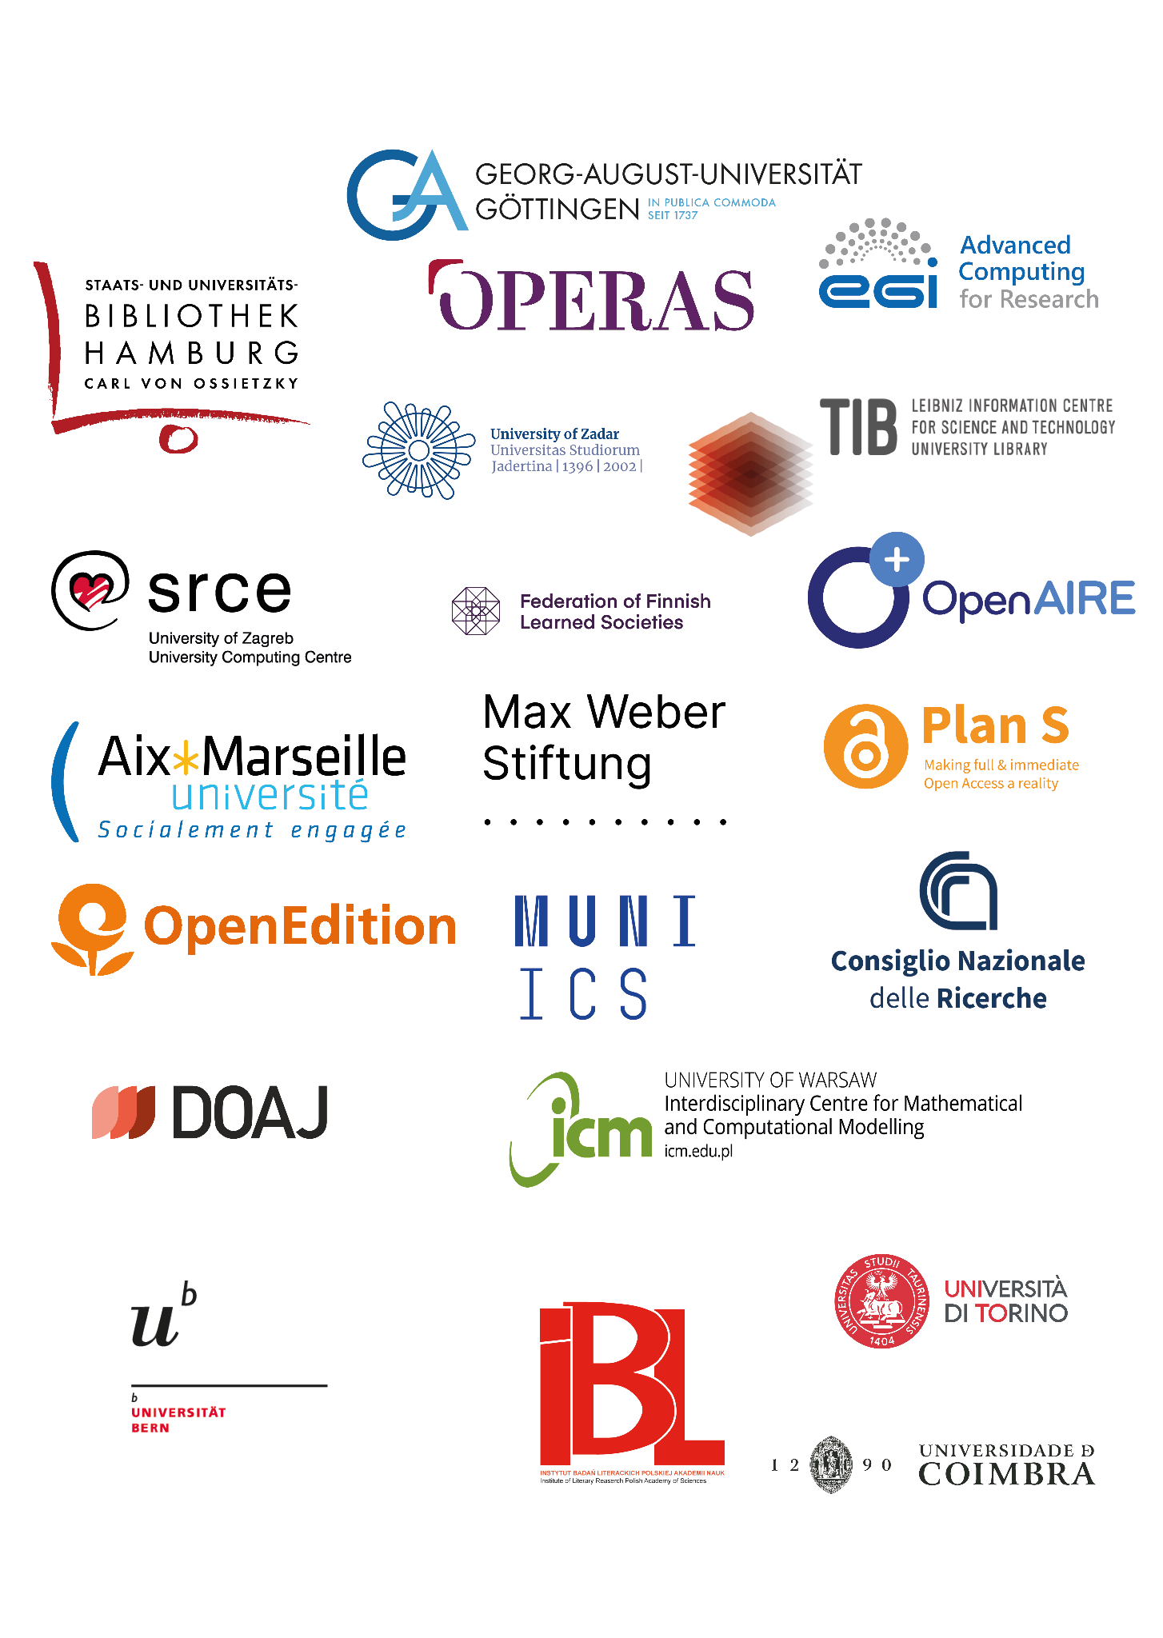

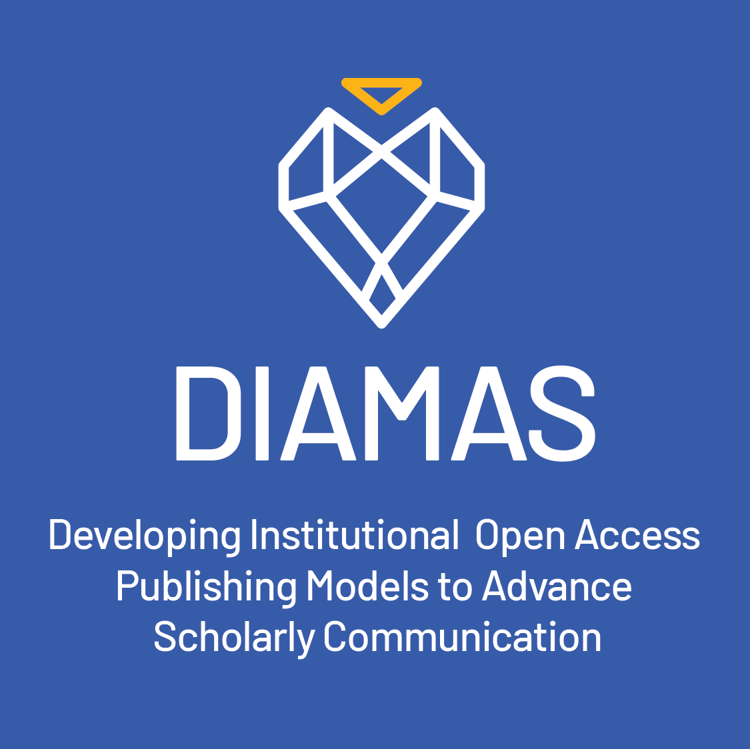
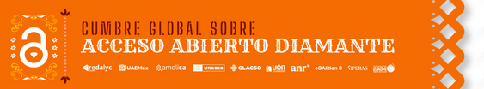
CRAFT-OA collaborates and aligns with
Partners of the Consortium
OpenAIRE AMKE (research graph, tools, data enhancement, EOSC onboarding)
CoalitionS (policy building, PlanS)
Directory of Open Access Journals (basic publishing infrastructure)
OPERAS AISBL (sustainability, connection to HSS communities)
EGI (AAI infrastructure, EOSC onboarding)
Association of European University Presses (scholarly communities, networking editors and publishers
EOSC Association
Representatives in the joint advisory board
PKP (release management of OJS, community building)
Lyrasis (release management of Dspace, community building
Sister projects and initiatives
Project DIAMAS – Developing institutional Open Access Publishing Models to Advance Scholarly Communication, with EQSIP - Extensible Quality Standard for Institutional Publishing)
Project PALOMERA– Policy Alignment of Open Access Monographs in the European Research Area
And many more

Slide 8
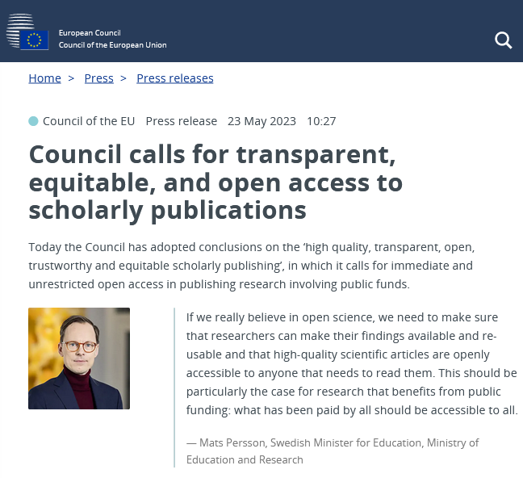
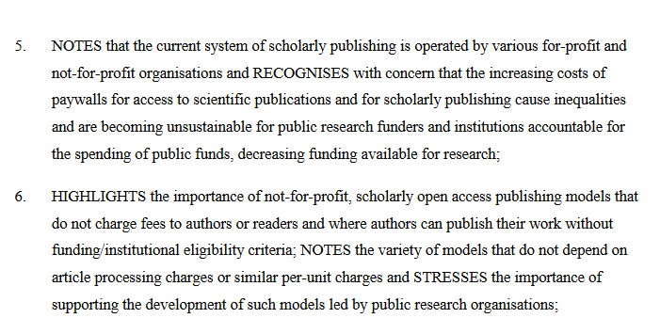
Vision? Making Institutional Diamond Open Access a default!
Creating a trusted and federated system for scholarly publishing,
sustainable and governed by science itself
Contributing to open science paradigms,
Making FAIR the default in open access publishing
Bringing institutional publishing and HSS into the EOSC

