Slide 1


FAIRCORE4EOSC in a nutshell
- Just completed the first year -
Full name: Developing EOSC-Core components to enable a FAIR EOSC ecosystem
Research and Innovation Action
Budget: 10 million EUR
Duration: June 2022 – May 2025
Consortium: 22 partners, coordinated by CSC – IT Center for Science
Coordinator Tommi Suominen (CSC), Project Manager Anu Märkälä (CSC) and Technical Coordinator Mark van de Sanden (SURF)
Website: faircore4eosc.eu
Key results: In response to the gaps identified in the SRIA, the project will develop nine new EOSC-Core components aimed to improve the discoverability and interoperability of an increased amount of research outputs.
Amsterdam, Netherlands – Kick-off meeting, June 2022
FAIRCORE4EOSC | Tommi Suominen

Slide 2
Key Contributions to EOSC SRIA
Contribution of <Project Name>
Description of the contribution of the project to the Strategic and Operational objectives of the SRIA and its Action Areas (A selection, no detailed description of all work packages needed).
FAIRCORE4EOSC is research and innovation action that focusses on concrete service development to further the realisation of the MVE and web of FAIR data.
Based on the gaps identified in the SRIA we focus on the topics of
Persistent identifiers
Metadata and ontologies
Interoperability
Additionally, the SIRS report identified Research Software as an additional focus point, picked up by the call text we addressed
Research software

Slide 3

Challenges addressed
FAIRCORE4EOSC is research and innovation action that focusses on concrete service development to further the realisation of the MVE and web of FAIR data.
Priorities highlighted in the SRIA are the establishment of the Web of FAIR data and a Minimum Viable EOSC (MVE) by 2027, that is the core components and functions to enable EOSC to operate (the EOSC-Core).
Identifiers: Introducing new resource types; machine-actionable persistent identifiers (PIDs); establishing a PID meta-resolver; standardising PID graphs; PID compliance framework to ensure compliance to the EOSC PID policy and to ensure quality of service for PIDs;
Metadata and Ontologies: Provide or embrace/stimulate existing registries of metadata schemas, ontologies and crosswalks, develop services that build on metadata registries and can facilitate the creation and sharing of crosswalks;
Interoperability: Enable discovery of data sources available in different formats, making search tools available; Provide tools for quality validation of metadata records and of digital objects; Implement EOSC PID Policy;
Research Software: metadata description standards for research software, automated deposit of new releases into a scholarly repository and Software Heritage.
FAIRCORE4EOSC | Tommi Suominen
Notes:
The seven areas relating to the primarily technical challenges and prerequisites to implementing the EOSC ecosystem are:
● Identifiers;
● Metadata and ontologies;
● FAIR metrics and certification;
● Authentication and authorisation infrastructure;
● User environments;
● Resource provider environments;
● EOSC Interoperability Framework.

Slide 4
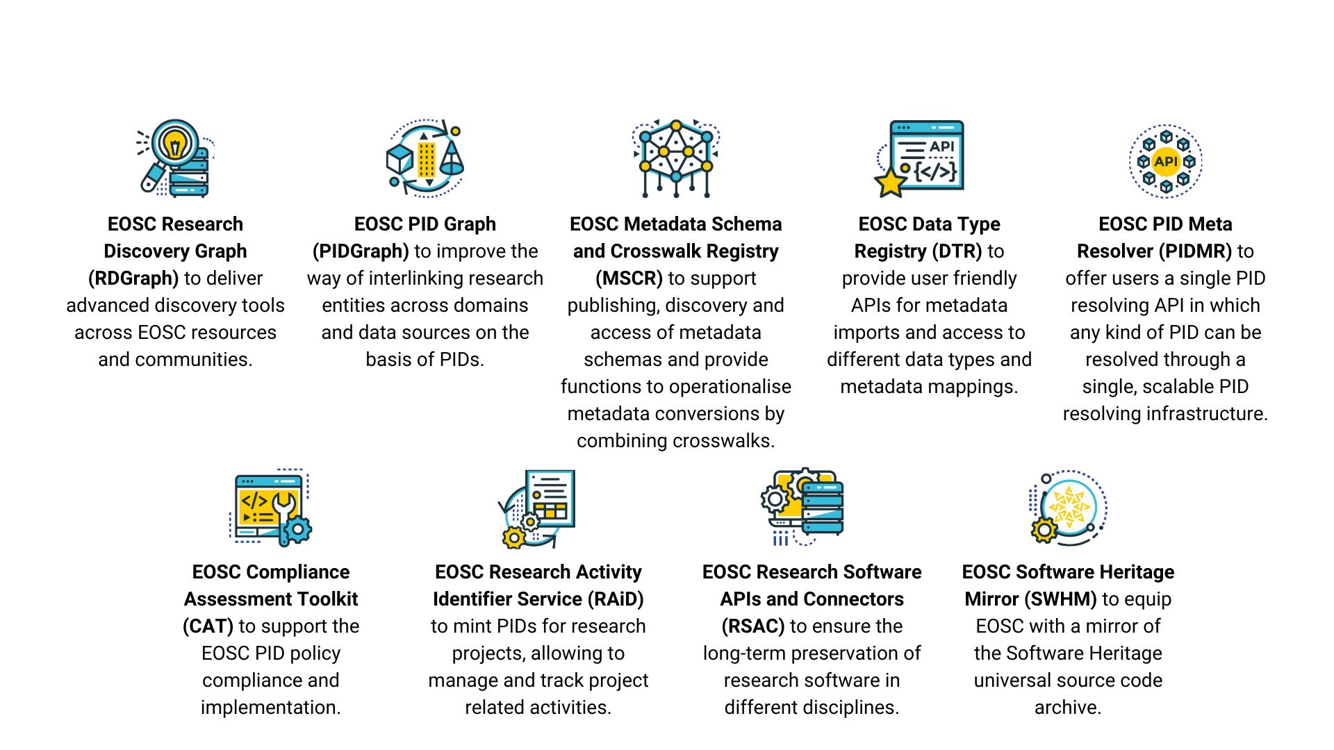
FAIRCORE4EOSC develops 9 new EOSC CORE components to address gaps identified in the SRIA
FAIRCORE4EOSC | Tommi Suominen

Slide 5
Contributions areas according to the EOSC SRIA
Contribution of FAIRCORE4EOSC
Operational objectives (at least)
OO1 Deliver and operate all the necessary components of the Minimum Viable EOSC
OO5 Provide the technical components of a FAIR ecosystem
OO7 Co-develop a first generation of a robust pan-European network of infrastructures for software source code
OO11 Implement the EOSC persistent identifier (PID) policy and architecture by 2025
Notes:
Description of the contribution of the project to the Strategic and Operational objectives of the SRIA and its Action Areas.

Slide 6
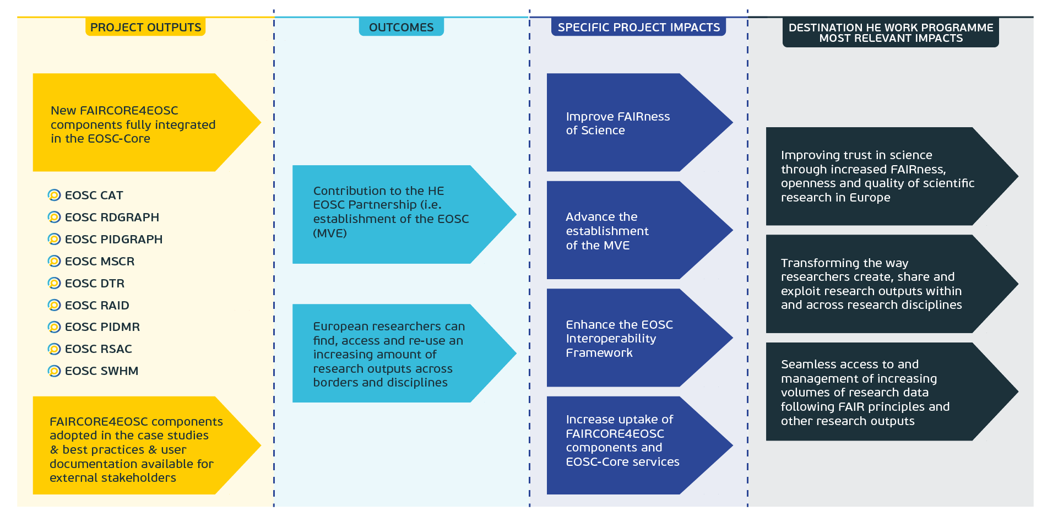
Key impacts
FAIRCORE4EOSC | Tommi Suominen

Slide 7
Key impacts and deliverables
<Project Name>
Description of the main impact that the project is planning to achieve and how they will be measuring it

Slide 8
Dependencies and Collaborations
FAIRCORE4EOSC
EOSC Future: in FC4E we are developing new core components that need to be integrated to the current core – this requires support and resources in order to support our adoption of e.g. the EOSC AAI.
FAIR-IMPACT: Joint events, joint workshops, inviting each other into eachother’s events. Regular interaction on the coordination level.
Technical Bridging Team regularly interfaces with several of the concurrent projects (on the next slide).
Participation of the FAIRCORE4EOSC partners to many of the EOSC Association TFs
Participation in the EOSC WGs: HE Coordinators, HE technology, HE IMPACT …. (EOSC Focus)
Active participation in RDA, as a representation of a global audience
As the implementation progresses, interest in the outputs is picking up. A LoI was signed recently with the BioDT project, who wish to use our outputs. More are in the works.
Notes:
The most relevant EOSC Association TFs see the participation of the FAIRCORE4EOSC partners: Technical Interoperability of Data and Services TF (7 members); PID Policy and Implementation TF (5 members); Infrastructure for Quality Research Software (5 members); FAIR Metrics and Data Quality TF (3 members); Semantic Interoperability TF (3 members); Long-Term Data Preservation TF (3 members); AAI Architecture TF (3 members); Rules of Participation Compliance Monitoring TF (2 members); Defining Funding Models for EOSC TF (2 members); Researcher Engagement and Adoption TF (1 member). This broad representation ensures that the project views and outcomes are reflected in and aligned with the new EOSC SRIA.
Dependencies on other projects/initiatives (if any) and collaborations established with other projects/initiatives relevant for the development of the EOSC

Slide 9






Technical Bridging Team
Task Forces
Aligning developments with the EOSC ecosystem
The Technical Bridging Team will provide a key link between the FAIRCORE4EOSC Technical Steering Group and the relevant interfaces in the Horizon Europe project FAIR-IMPACT.
FAIRCORE4EOSC will interact with the wider EOSC community, through dialogue and joint activities with the EOSC Association, its Task Forces, the EOSC Future project, and other key initiatives.
EOSC projects
FAIRCORE4EOSC | Tommi Suominen

Slide 10
Sustainability and interoperability are key
FAIRCORE4EOSC
A key concern for FAIRCORE4EOSC is the sustainability of some of the outputs of the project, especially services that will require a constant input of resources to be kept running. We are developing components for the EOSC core. What is the partnership / EC plan for maintaining this new iteration of core components?
The more successful we are in our KPIs related to adoption of the developed new components, the more critical we make these services to their users. We have already now adopters who weigh starting to invest in using our solutions, against the risk of discontinuity. We need clear and communicable service sustainability pathways.
In some cases, when EOSC level services have high strategic national relevance, willingness from national funders may be found. But its not a commonplace narrative. National priorities may also differ between countries and will unlikely result in Open European services.
While a recent issue, access to CORE services, by new the new core services we develop, has not been factored into EOSC FUTURE. They have however been receptive to our requests to integrate with EOSC AAI. It is also an important factor in the support for service development in the procurements.
Notes:
Final comments, identified challenges, suggestions, key observations or recommendations to other

Slide 11
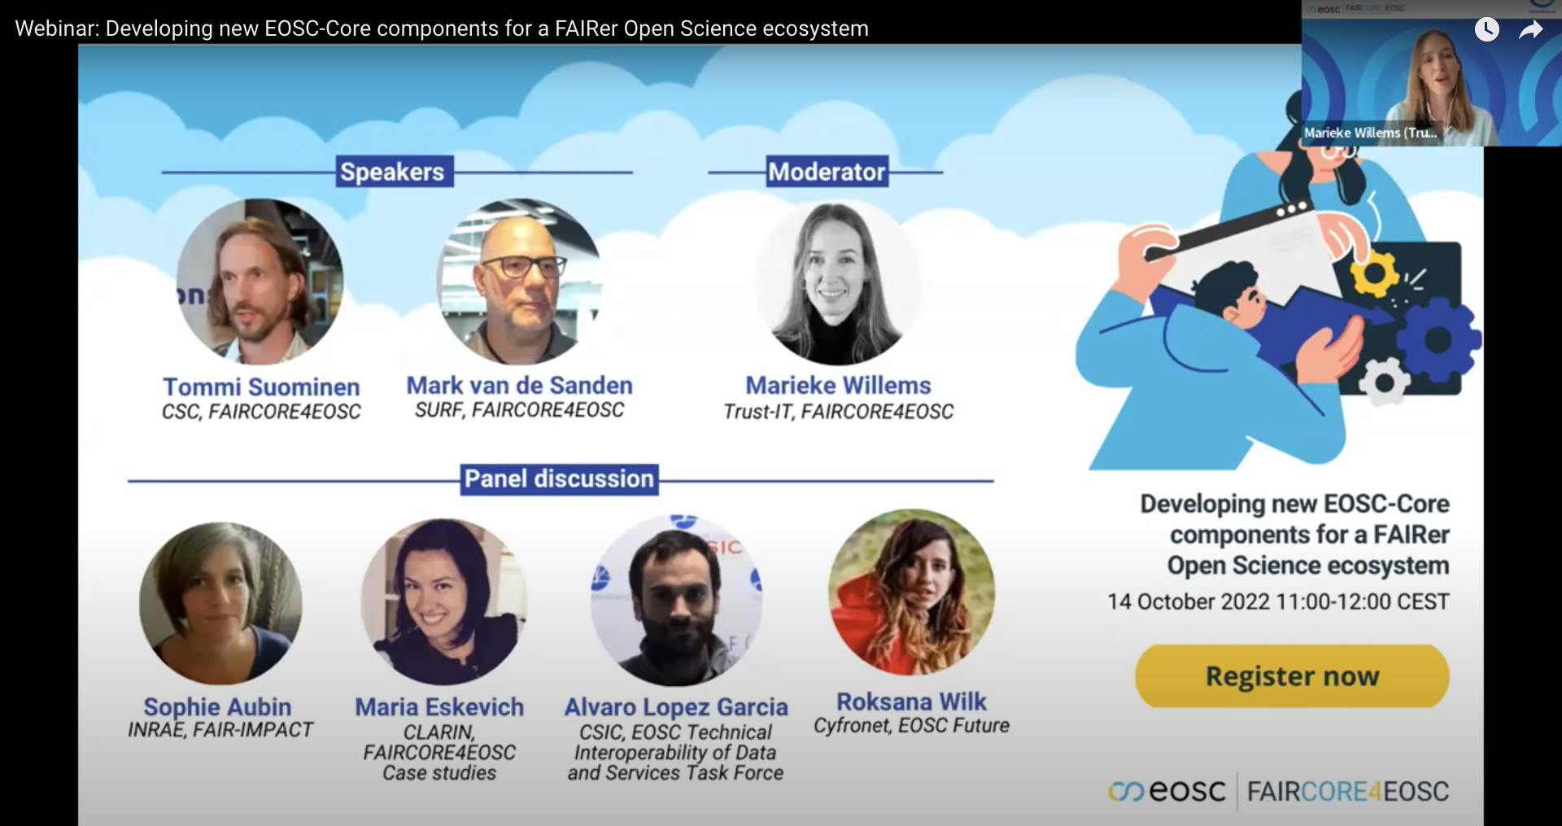

Scan to watch the webinar

