Slide 1
In a nutshell
Develops, assesses and puts into operation an open and trusted federated infrastructure for next generation research metrics and indicators.
A Research Assessment Dataspace: Offers data, tools, services and guidance to support and enable policy reforms for research assessment.
At three levels
individual/group researchers
research and funding performing organisation
country
Budget: 2.985Μ
Start date: 1/1/2023
Duration: 36M

Slide 2


















A multi-disciplinary consortium
Infrastructure experts
RRA + OS experts
Communities

Slide 3
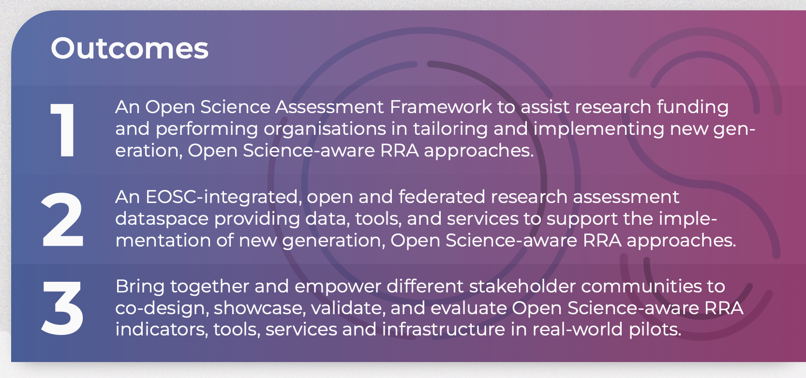
Important outcomes

Slide 4
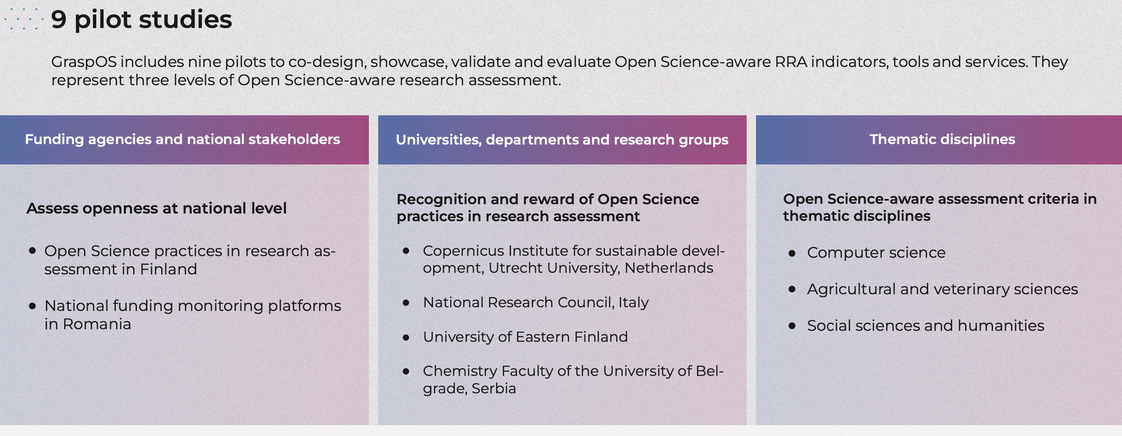

Slide 5












Build upon existing technologies & expertise

Slide 6
Relation to EOSC SRIA
More relevant action areas:
Landscape monitoring
Skills and training and/or rewards and recognition

Slide 7







Collaborations
First contact with:
To investigate:

Slide 8

THANK YOU
Let’s make it happen! Together.
https://graspos.eu/
@GraspOS_project
vergoulis@athenarc.gr

