Slide 1

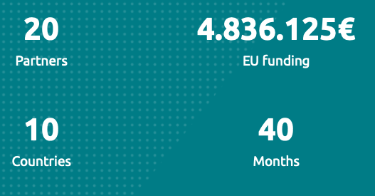

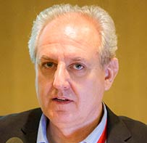
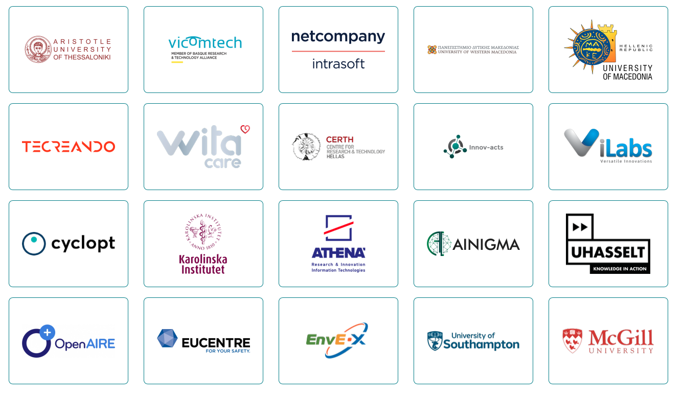

Project Name
Evdokimos Konstantinidis, Aristotle University of Thessaloniki
Project Coordinator
Gorka Epelde, VICOMTECH
Technical Coordinator
Panos Bamidis, Aristotle University of Thessaloniki
Scientific Coordinator
Project name: Research Analysis Identifier System
Start date: 1 October 2022
End date: 31 January 2026
Coordinator: Aristotelio Panepistimio Thessalonikis

Slide 2
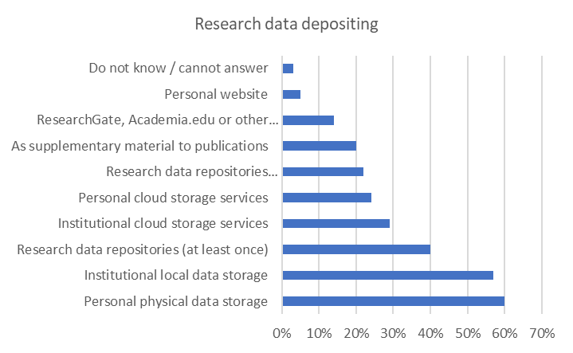
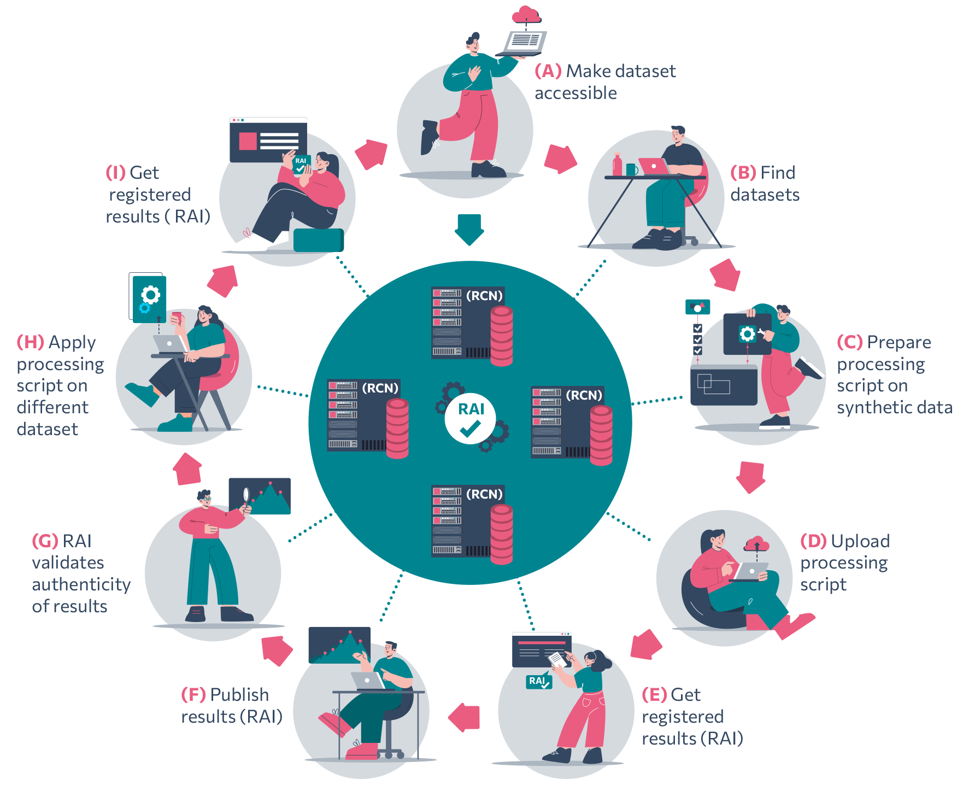
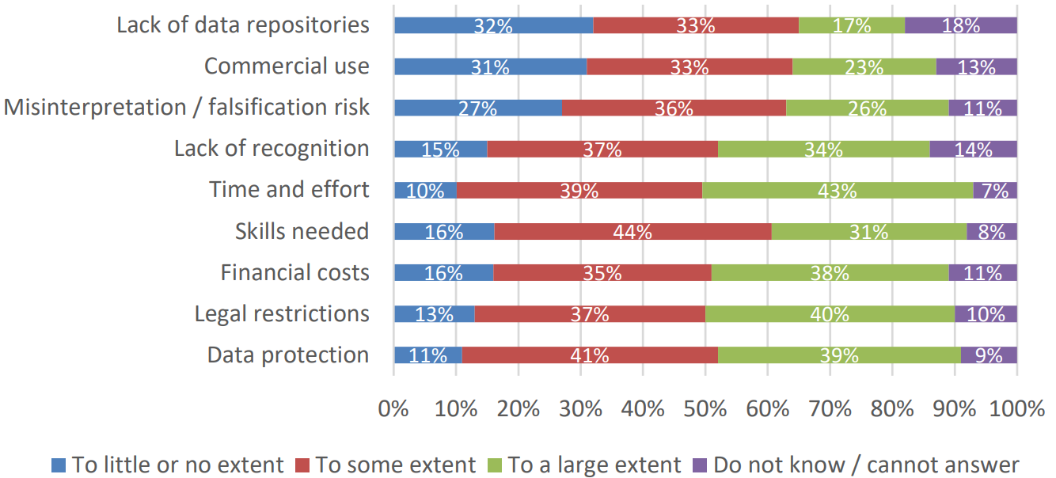
RAISE
the value of data is in processing them and not in owning them
RAISE works on moving from open data to data open for processing
Source: European Commission, Directorate-General for Research and Innovation, European Research Data Landscape : final report, Publications Office of the European Union, 2022, https://data.europa.eu/doi/10.2777/3648

Slide 3
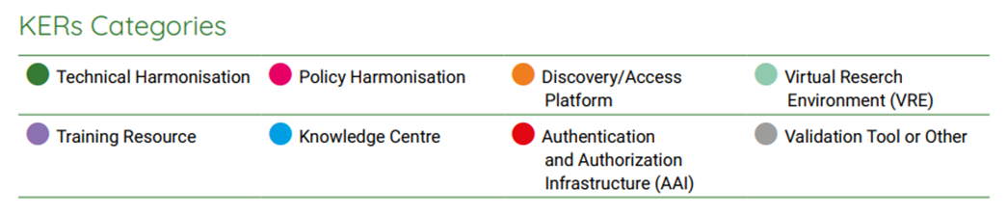
Key Contributions to EOSC SRIA
Contributions of EOSC-RAISE
1. SRIA Action Area: Resource provider environments
SRIA Priority: Incentivise resource providers to produce and operate resources that are Open Science by design.
EOSC-RAISE outcome: Reproducible open research with controlled and protected datasets.
Mapping to KER category: Virtual Research Environment (VRE)
Link to task forces: Infrastructures for Quality Research Software
2. SRIA Action Area: Persistent Identifiers
SRIA Priority: Develop standardised identifiers for resource types that have not as yet become standard practice.
EOSC-RAISE outcome: Research Analysis Identifier (RAI) of experiments-(including hashed identifiers of dataset, script, results, author) written into the blockchain.
Mapping to KER category: Validation Tool, Technical and Policy Harmonisation
Link to task forces: PID Policy and Implementation

Slide 4
Key Contributions to EOSC SRIA
Contributions of EOSC-RAISE
3. SRIA Action Area: Metadata and ontologies
SRIA Priority: Develop EOSC guidelines for a minimum metadata desc. based on existing metadata schemas and tools to allow data discovery and metadata exchange across federated repositories and sci.comms
EOSC-RAISE outcome: Computer interpretable data usage agreement knowledge graph
Mapping to KER category: Discovery/Access Platform, Technical and Policy Harmonisation
Link to task forces: Semantic Interoperability
4. SRIA Action Area: Metadata and ontologies
SRIA Priority: Develop standardised identifiers for resource types that have not as yet become standard practice.
EOSC-RAISE outcome: Descriptive statistics for the data source types harmonised for RAISE advanced services within Pilots (Health, Environment & Smart mobility).
Mapping to KER category: Discovery/Access Platform, Technical Harmonisation
Link to task forces: Semantic Interoperability

Slide 5
Key Contributions to EOSC SRIA
Contributions of EOSC-RAISE
5. SRIA Action Area: Skills and training and/or Rewards and recognition
SRIA Priority: Culture change needs to be realised as current R&R systems poorly reward and recognise Open Science and FAIR practices
EOSC-RAISE outcome: Data owner and researcher acknowledgment by retrieving and visualising dataset and script usage metrics, and researcher performed experiment results citations (RAI, DOI, Crossref)
Mapping to KER category: Technical Harmonisation
Link to task forces: Research careers, recognition and credit

Slide 6
Key impacts and deliverables
EOSC-RAISE
Technical top priorities:
Enable reproducible open research with controlled and protected datasets
Experiment PID (dataset, script, results, author) Research Analysis Identifier
Key impacts:
Transforming the way researchers, share and exploit research outputs
Seamless access to and management of increasing volumes of research data following FAIR principles
Improving trust in science through increased FAIRness and contribution acknowledgment
Create a crowdsource community of data sharing

Slide 7
Dependencies and Collaborations
EOSC-RAISE
In contact with GEANT to integrate / use of EOSC AAI
In contact with OpenAIRE to make EOSC-RAISE hosted datasets metadata available at OpenAIRE Graph
The starting point for the architecture and a first version of simple prototypes of some RAISE services came from VITALISE H2020 (H2020-INFRAIA-2020-1)
Identified many relevant activities (for future?) from FAIRCORE4EOSC presentation in EOSC HE technical meeting:
  Metadata Schema and Crosswalk Registry
    EOSC-RAISE is working to define data models for its pilots on (Health, Environment, Smart mobility)
  Research Activity Identifier (RAiD) – PID for research projects and related activities
    Could be interesting to add EOSC RAISE RAI id (experiment results id (script, researcher, dataset, results PIDs))
  PID Meta Resolver
    Integrate EOSC RAISE RAI id with the service to facilitate access/info on experiment results components
  RS API
    To seek for EOSC RAISE uploaded, versioned script / algorithms
Contribute with storage and processing resources to EOSC after the end of the project

Slide 8
Your vision
EOSC-RAISE
Researcher centered and not data centered design
Our VISION is the EOSC Web of FAIR Data and Services for Science is an open, fair and reliable Research Community where every researcher will be accredited for their work and all research data will be equally accessible for processing without violating data protection regulations.
RAISE is to provide the infrastructure for a distributed crowdsourced data processing system, moving from open data to data open for processing. RAISE will provide the mechanism for sending the algorithm to the dataset instead of sending the data to the algorithm.
If we could suggest:
Common framework for requirements collection and management.

Slide 9
Thank you
Evdokimos Konstantinidis, Aristotle University of Thessaloniki
Project Coordinator, evdokimosk@gmail.com
Gorka Epelde, VICOMTECH
Technical Coordinator, gepelde@vicomtech.org
Online presence
https://raise-science.eu/
https://twitter.com/RaiseScience
https://www.facebook.com/raise.science
https://www.linkedin.com/company/raise-science/

