Slide 1
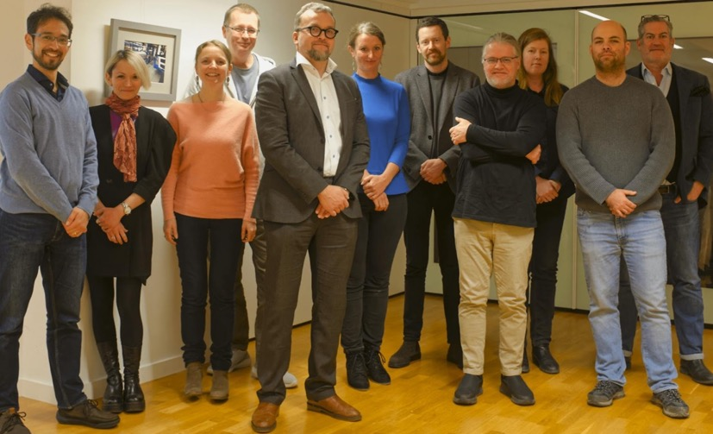






RDA TIGER
In a Nutshell
1.1.2023 – 31.12.2025
3 M€
4 Beneficiaries
Coodinated by RDA Association
Coordinated by:
Project Kick-off, Brussels, January 2023
Project Partners:

Slide 2

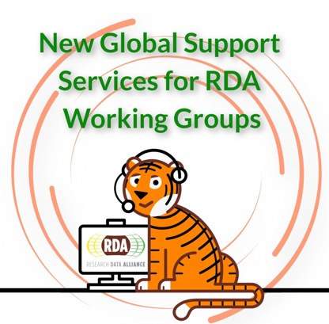
RDA TIGER CONCEPT
“Supporting the Internationalisation of EOSC via Research Data Alliance Working Groups”
Scientist work globally and use global solutions
EOSC is not alone in the global Open Research Commons developments (!).
It is better to discuss already in the development phase with global partners.
Research Data Alliance provides for this:
existing platform and process : RDA Working Group (RDA WG)
Connection to global partners: Over 10k RDA members
Pathway to formalisation: Official RDA Recommendations
RDA TIGER helps with this access by
Lowering the barrier to start and run a RDA WG with international partners
Supporting the RDA WG output creation and impact
10 years in operation
Global
Over 10k members
Targeted international collaboration
Mostly virtual, meetings also in RDA plenaries
Max 18 months to create outputs

Slide 3
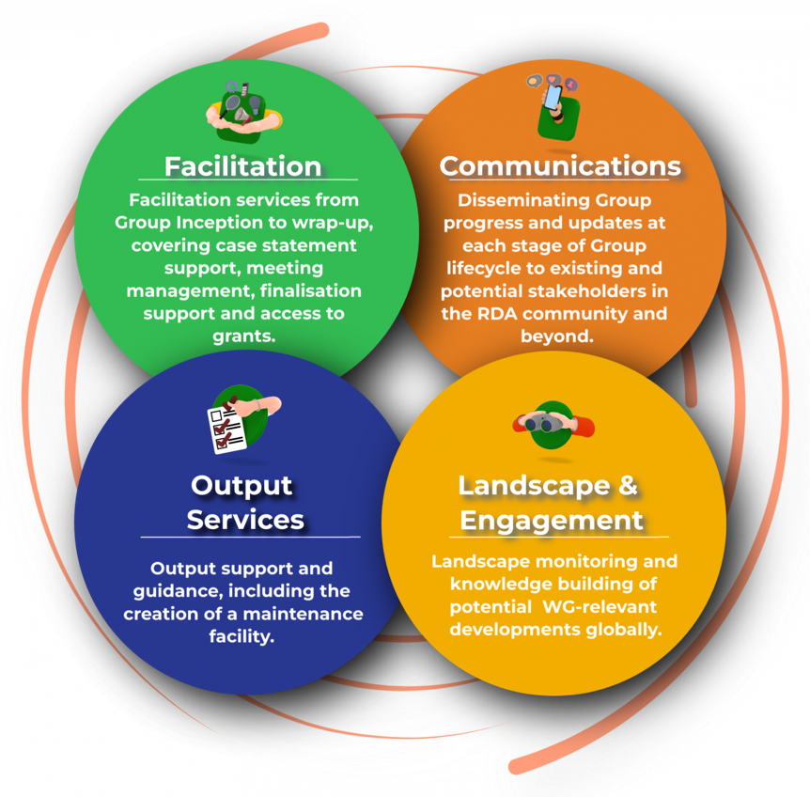
RDA TIGER services for your project needs
We can offer you a selection of internationalisation services via RDA Working Groups:
Faciliate starting and running of a RDA Working Group
Find and Engage correct international partners
Communicate the WG activities
Support the WG work with small grants
Help to create impactful outputs from the WG
“Let experts concentrate
being experts”
“Communication is the key to collaboration”
“Direct support where
needed”
“Outputs are impactful and used”
“Groups should have right participants and representation”

Slide 4
Key Contributions to EOSC SRIA
Contribution of RDA TIGER
Widening to public and private sectors and going global
RDA TIGER is specifically designed to support internationalisation of EOSC developments:
Create and support RDA WGs helping to create international standards (small s)
Connect to Open Research Commons globally
Support funder collaboration internationally
Bring new parties to Open Research Commons discussions
Support creation of new recognition and assessment mechanisms
Other SRIA areas are potentially answered by bottom-up WGs
Current examples include:
Research Software monitoring and evaluation guidelines (upcoming WG)
National PID strategies checklist (finishing WG)
Global Open Research Commons – definition of key aspects and a global analysis (finishing WG)

Slide 5
Key impacts and deliverables
RDA TIGER
Key deliverable:
RDA Service platform (definitions, QC, and practical processes) for supporting RDA Working Groups:
Faciliation service (WP5)
Communication service (WP2)
Output support service (WP4)
Landscape analysis support (WP3) – including a global open science landscape database platform
Direct support service (WP1) – including 3rd party (cascading) grants
Key impacts
Internationalisation of EOSC Activities and supporting global open research commons development
Number of supported EOSC-related WGs
Number and quality of the WG outputs
Service satisfaction
Further developing the RDA global collaboration environment
Vision of sustained global support for international collaboration

Slide 6
Dependencies and Collaborations
RDA TIGER
There are no direct dependencies inside the EOSC projects, but many collaborations:
EOSC FOCUS collaboration on Landscape analysis
EOSC FUTURE collaboration on RDA Graph Database (for landscape analysis support) and support of Global Research Commons developments (RDA WG).
WorldFAIR collaboration on international disciplinary FAIR pathways (potential RDA WGs)
FAIR-IMPACT collaboration on engaging data spaces for Landscape analysis and new RDA WGs
Hopefully: new WGs from projects participating today!

Slide 7

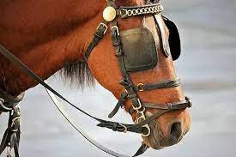
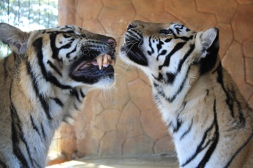
Your vision
This Photo by Unknown Author is licensed under CC BY
RDA TIGER
Vision: Sustained support for collaborative development of EOSC together with international partners
Suggestions:
When developing your solutions in the projects, consider if it can have international dimension (outside of EU);
Try to avoid “not invented here” or “Build first, look around last” attitudes
RDA provides low barrier international forum and process for collaboration
RDA TIGER can provide additional in-kind and direct support for collaboration
Additional suggestion: Project or a group to build best practices for 3rd party support (cascading grants) and other support mechanisms to non-beneficiaries – particularly in international contexts

