Slide 1
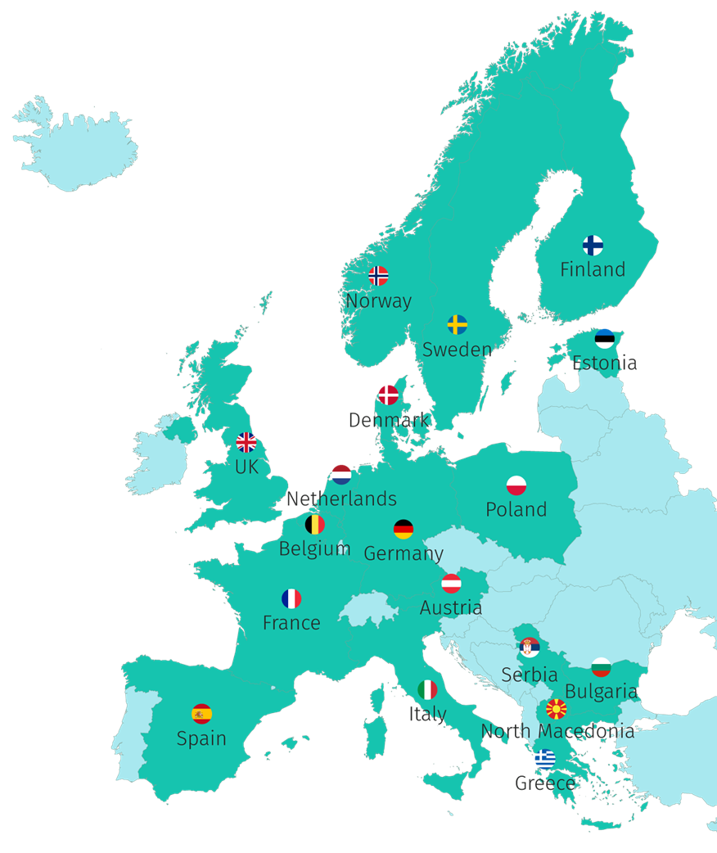






44 Participants, 18 Countries
Coordinator: Consortium GARR, Italy
“Key doers” in Open Science in their Country/Region/Domain
2 ESFRI Research Infrastructures
7 million €, co-funded by European Union and UK Research and Innovation
September 2022 – August 2025

Slide 2



How?
Some of the ways we will achieve our goals...
Propose
Coordinate
Enable
A FAIR-by-design methodology for open science teaching and learning
Network of Competence Centers on Open Science and FAIR Data
Key competences for an EOSC-skilled European workforce

Slide 3
Key Contributions to EOSC SRIA of Skills4EOSC
Addressing three skills-related gaps identified in SRIA:
  A lack of open science and data expertise
  A lack of clearly defined data professional profiles (and career paths)
  Fragmentation in training resources
Through these mechanisms:
Leveraging the Competence Centre concept to:
  pool existing competences in institutions and RI/e-Infrastructures;
  set out a ToT strategy;
  act as multipliers to provide lifelong training locally.
On Profiles:
  map existing professional profiles, defining a harmonised Minimum Viable Skillset for each of them (using co-creation);
  harmonise the relevant curricula and competence accreditation mechanisms;
  engage with RPOs, university networks, funders and national training programmes to ensure their recognition and adoption.
Fragmentation:
  Provide a methodology for FAIR-by-Design training resources, encompassing practical information on how to use the resources
  Promote creation of national training catalogues & interoperation with the EOSC platform.
The availability of FAIR Open Educational Resources will boost the capacity of Competence Centres and institutions to deliver quality training that matches the needs of different communities.

Slide 4
Key Contributions to EOSC SRIA of Skills4EOSC - (2)
Designing & delivering training targeting different roles in the Open Science context, e.g.:
  Researchers
  Support staff
  Policy makers
  Civil servants
Training includes key messages and learning outcomes specific to the target audience
Coordinated network of competence centres
  National
  Regional
  Thematic
...Empowered to support implementation of Open Science & train all stakeholders we identify
Creation of a shared and trusted framework for competencies recognition for Academic and lifelong learning
  Standardised soft certifications (e.g. open badges) will be available
  Framework to be adopted by CCs and other professional training providers.
  Accreditation brings recognition – helps professionals & those who want to employ them

Slide 5
Key impacts and deliverables
  Fixing the gaps identified in the SRIA:
    A lack of open science and data expertise
    A lack of clearly defined data professional profiles (and career paths)
    Fragmentation in training resources
  .. And doing so in a sustainable way:
  through national & domain competence centres that can continue the work
  Through engagement and acceptance of skills profiles and certification by relevant actors
  Reaching those such as policy makers & civil servants who have not received as much attention in earlier work related to Open Science skills
  As a result of our work, we expect to see:
  More people with Open Science skills and understanding
  Clearer career paths for many of these people
  Wider recognition of their skills and qualifications
  Direct economic & societal benefit as a result

Slide 6
Dependencies and Collaborations
No strict dependencies – we do not have outcomes that are strictly dependent on the actions of others
Current Collaborations:
Existing with FAIR-Impact
Liaison with EOSC-Future to ensure we are not duplicating work
Potential collaborations:
We hope to use today to identify more – at the last concertation meeting our work was at too early a stage (as was that of others) to make concrete, specific agreements
FAIRCORE4EOSC are amongst those we expect to speak with – also RDA Tiger
What could help us?
Results from EOSC Focus interview process under HE developments group – share them!

Slide 7
Your vision, challenges, suggestions etc
Competence centres should be recognised as amongst the important intermediaries in the EOSC vision
There are other relevant projects (in domain infrastructures, for instance) who aren’t invited to this meeting but with which we expect significant interaction – let’s not lose sight of them
We think we understand what we need to do for ‘sustainability’ – but is this being understood in the same way by everyone? (And does that matter?)

