Slide 1

Support to Reinforce ESFRI 3
Fotis Karayannis-Tasos Patrikakos
Athena Research Centre

Slide 2
Project overview
Support to Reinforce ESFRI 3
Successor project to StR-ESFRI2 (2019 –2022)
4-year CSA under Horizon Europe
Start: 1st April 2022 End: 31st March 2026
€2.5M (0.625M per annum)

Slide 3
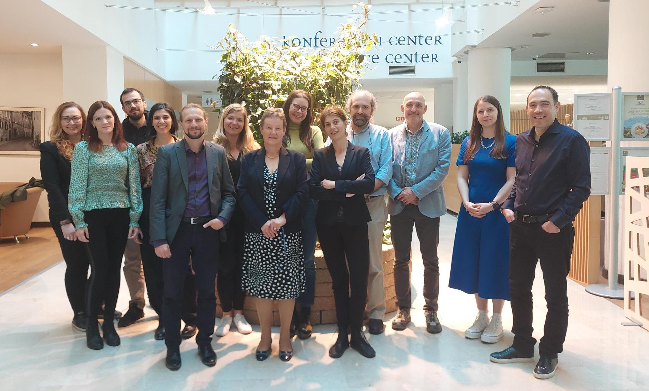
Consortium
UMIL
HIPC
Athena RC
UL
Photo: StR-ESFRI2-StR-ESFRI3 transition meeting
ATHENA RESEARCH AND INNOVATION CENTER (ATHENA) | EL
USTAV FYZIKALNI CHEMIE J. HEYROVSKEHO AV CR (HIPC) | CZ
UNIVERSITA DEGLI STUDI DI MILANO (UMIL) | IT
UNIVERZA V LJUBLJANI (UL) | SI
Notes:
Note: It was not possible for UKRI to remain as coordinator before UK associates to Horizon Europe

Slide 4
Goal
“Further strengthen ESFRI under the guidance of its Chairs*, and in close cooperation with the EC-based ESFRI secretariat, by providing additional resources, tools and expertise to support ESFRI activities and structures.”
* 2022-2025

Slide 5
StR-ESFRI3 Objectives
Supporting the ESFRI Chairs and related structures
Supporting the effective review, monitoring and assessment of ESFRI RIs
Supporting the Landscape/Gap Analyses and next ESFRI Roadmap
Communicating, Disseminating, Engaging with key stakeholders
Fostering the strategic positioning of ESFRI within the ERA (incl. EOSC)
Planning for a sustainable ESFRI support structure (ESFRI office)

Slide 6


Disclaimer
The views expressed here are opinions of the StR-ESFRI3 EOSC team, and do not necessary constitute ESFRI ones

Slide 7
About ESFRI (1)
European Strategy Forum on Research Infrastructures
  brings together national representatives and EC
  supports a coherent & strategy-led approach to policy-making on RIs in Europe
  Its outputs include an ESFRI Roadmap for RIs of pan-European interest
  €25 billion investment agenda in new facilities or major upgrades
    spanning all scientific domains, enabling curiosity-driven, responsible and socially relevant research
Slide by Jana Kolar – ESFRI Chair
ESFRI and EOSC, Slovenia Open Science Day, October 2022

Slide 8
About ESFRI (2) – Activities
Facilitates coordination & implementation of EU RI policies, by:
  strategic analysis of EU RI landscape
    identifying scientific and political needs, enabling gap analysis and priority setting
  development of periodic RI Roadmaps
    state-of-the-art landscape of EU RIs and supporting their shared use
  monitoring RI performance
    insights into their outputs/impacts and supporting their further development
  regular exchanges with RIs and their broad user communities
  policy exchanges/coordination supporting further development of the RI ecosystem:
    on topics such as international cooperation, open access to data, open science, financing, industry cooperation, energy crisis, impact assessment
Slide by Jana Kolar – ESFRI Chair
ESFRI and EOSC, Slovenia Open Science Day, October 2022

Slide 9
Key Contributions to EOSC SRIA (1)
Contributions of StR-ESFRI3 to SRIA – User Environment
Since ESFRI deals with all thematic communities this SRIA area is important
3rd ESFRI-EOSC workshop topic (Jan 2022) “What does EOSC bring to RI users?”
  Feedback from the audience was requested
  Workshop report also summarises the key points
    More work needed for thematic communities/ researchers-/RI users to fully benefit from the EOSC added value
    A call for the development of a user-friendly and comprehensive catalogue of available EOSC services was made, as well as corresponding use cases, success stories, and demos, that clearly highlight the EOSC benefits
    The role of ESFRI and of other thematic RIs is crucial to speed up OS
    Providing a clearer vision of the EOSC services which will become available for the users, including the EOSC marketplace
    Different needs, speeds/levels of uptake of FAIR and Open Science practices by different thematic communities → appropriate care needed
    Trade-off between young researchers who want to move away from the traditional thematic portals and adopt modern, targeted tools for each researcher (personalized dashboard), and older generations (retain them)
    Role of national constituents and thematic clusters
    Training and guidance on the use of the EOSC services and the provision of an EOSC helpdesk as part of the EOSC platform
“EOSC should prioritise its efforts for providing clearer added-value for end users”
“Ongoing efforts to build a user-driven EOSC must intensify, complemented by concrete use cases

Slide 10
Key Contributions to EOSC SRIA (2)
Contributions of StR-ESFRI3 to SRIA – Landscape Monitoring
Main area within ESFRI – Landscape Analysis
ESFRI Roadmaps and Landscape/Gap Analyses
  ESFRI publishes every few years its ESFRI Roadmaps (last in 2021)
  Part of Roadmaps “Landscape Analysis” section of RIs.
  Sub-area: Data, Computing and Digital RIs (DIGIT)
    DIGIT ESFRI Strategy Working Group (SWG), which includes EOSC.
  The next LA separate (disjoint) from the ESFRI Roadmap
    Call for contributions to all ESFRI Stakeholders earlier this year
    Answers received: Landscape Analysis | www.esfri.eu
    The ESFRI LA expected to be delivered ~end of this year
  StR-ESFRI supports the LA process, both technically (questionnaire to stakeholders, questionnaire to RIs via MoS , analysis of answers) and also later on in the editorial work.

Slide 11
Key Contributions to EOSC SRIA (3)
Contributions of StR-ESFRI3 to SRIA –EOSC Interoperability Framework
The ESFRI Monitoring System – Interconnection with EOSC?
ESFRI MOS
  StR-ESFRI supports ESFRI by developing a web-based system named “ESFRI Monitoring System” or ESFRI MoS.
  Central repository with set of info for all ESFRI Ris
    General information (descriptions, timeline, legal entities)
    Data about the Political Support and Financial Commitment for each RI.
  Current version of MoS private to ESFRI delegations and RIs
  A public version of MoS planned
    Can be served through an interoperable web service
    Facilitating exchange with other repositories
    Ensuring that the available data are always up to date
    This is planned in the next ~2-3 years
  National CRIS systems may be able to harvest some info
  Consider link with EOSC Observatory/monitoring.

Slide 12
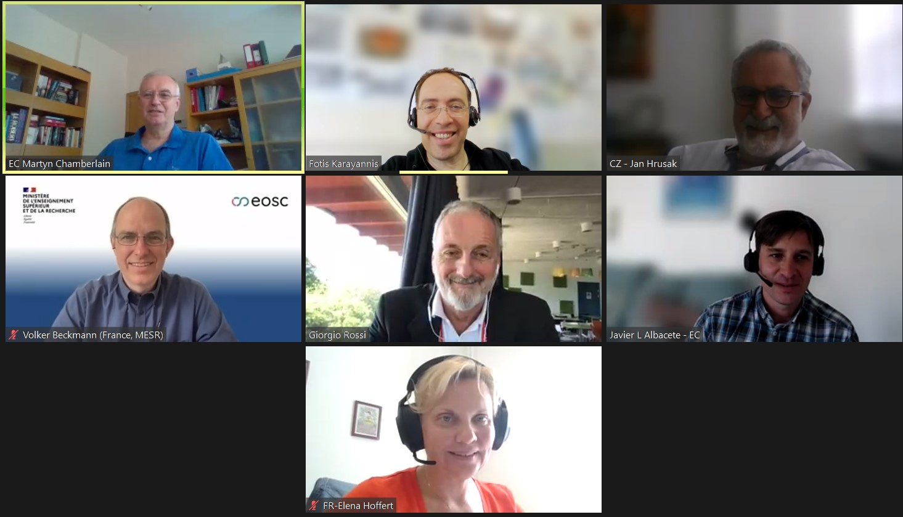
Key impacts and deliverables
StR-ESFRI3 – Impact related to EOSC → Support the new ESFRI-EOSC Task Force
ERAC and the Competitiveness Council recognised a key role of ESFRI and thematic RIs working together with EOSC core developers/operators to speed up implementation of Open Science policy/FAIR data
Considered that coordination between ESFRI and the EOSC Steering Board is needed
New ESFRI-EOSC Task Force established - First meeting 12 June 2023.
Task Force members:
  EOSC SB: Volker Beckmann (TF Chair 6 months), Giorgio Rossi
  ESFRI: Elena Hoffert and Jan Hrušak
  EC: Javier Lopez Albacete and Martyn Chamberlain
  Observers: ERIC Forum, the EIRO forum, the EOSC Association, the e-IRG and on a rotational 6-month basis, one representative of European RI networks registered to the ESFRI Stakeholder Forum
  Mandate: Current ERA Policy Agenda (until end of 2024) with the possibility for renewal.
General objective: structured interface between ESFRI and EOSC SB (beyond the current ad-hoc cooperation).
Possible work priorities for first period:
  Help reducing fragmentation of the research data landscape in Europe by stimulating the connection of ESFRI Ris/ERICs to the EOSC federation
  Assisting in increasing of FAIR research data productivity in Europe

Slide 13
Dependencies and Collaborations
StR-ESFRI3
High-level (ESFRI): ESFRI-EOSC Task Force
  Collaborations with EOSC-SB, EOSC-A, RIs, e-IRG
Lower level:
  StR-ESFRI3 – EOSC-A / EOSC Forum
    Contributing to EOSC-A – EOSC Forum Groups
  StR-ESFRI3 – EOSC-A Task Forces
    TF Researcher Engagement and Adoption (REA)
    TF Sustainability
  ESFRI-EOSC TF? – StR-ESFRI3 – EOSC-A TF REA/other
    Joint workshop on Researchers Engagement/Added-value for EOSC (RI) users?

Slide 14
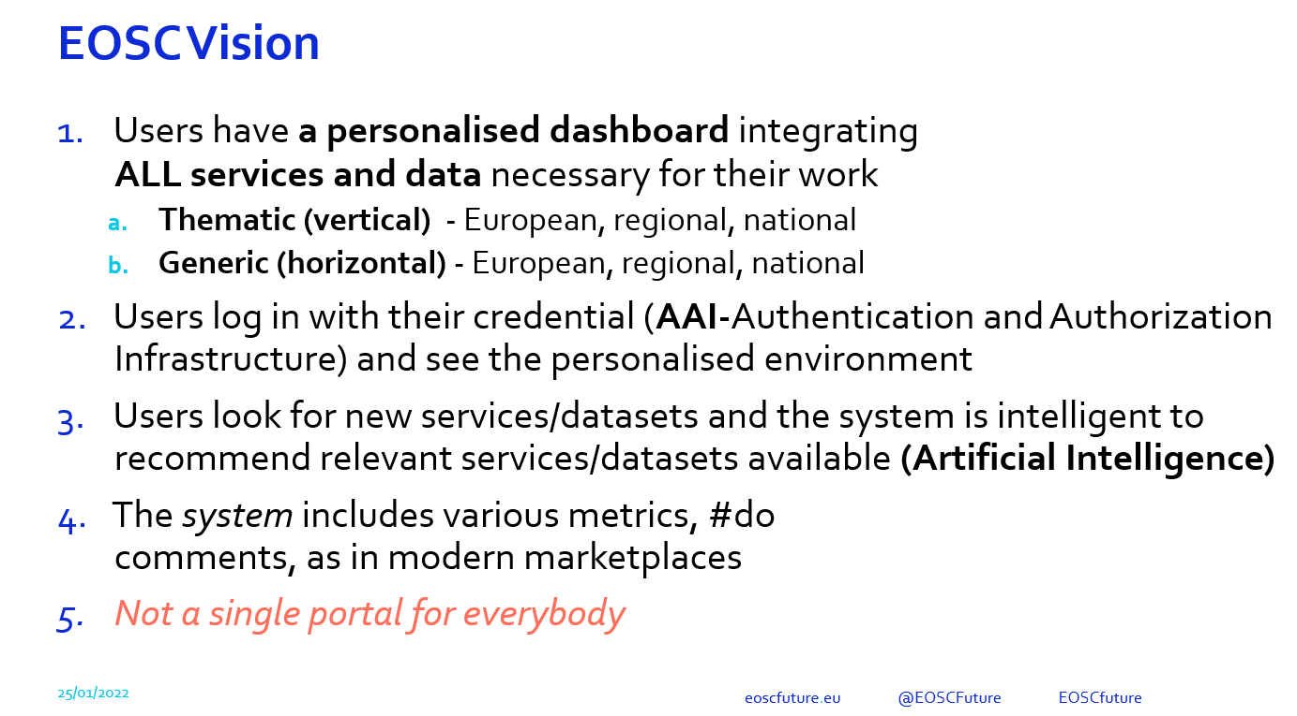
Your vision
StR-ESFRI3 – Slide by Yannis Ioannidis at 3rd ESFRI-EOSC Workshop, Jan 2022

Slide 15
Users
Users
Users
AAI
AAI
AAI
Thematic Cluster
Integrated core services
Thematic Cluster
Thematic core services
Cross-thematic/ integrated Data
Metadata Integration
S/W
Cross-thematic/integrated Services
Thematic core services
Data
Data Products
S/W
Services
Data
Data Products
S/W
Services
AAI
Users
Virtual Research Environments (EU/National)
Data infrastructures (EU/Regional/National)
including Scholarly Communications
Centralised RI1
Centralised RI4
Users
Multi-site
RI2
..
Multi-site
RI2
Multi-site
RI5
..
Multi-site
RI5
AAI
Distributed RI3
Distributed RI3
Distributed RI6
Distributed RI6
..
..
..
AAI
Computing and Storage infrastructures (EU/National)
Users
AAI
Other Services Infrastructures (AAI, Middleware/) (EU/National)
Users
AAI
Network Connectivity Infrastructures (EU/National)
Users

Slide 16
Users
Users
Users
AAI
AAI
AAI
EOSC
Thematic Cluster
Integrated core services
Thematic Cluster
Thematic core services
Cross-thematic/ integrated Data
Metadata Integration
S/W
Cross-thematic/integrated Services
Thematic core services
Data
Data Products
S/W
Services
Data
Data Products
S/W
Services
AAI
Users
Virtual Research Environments (EU/National)
Data infrastructures (EU/Regional/National)
including Scholarly Communitations
Centralised RI1
Centralised RI4
Users
Multi-site
RI2
..
Multi-site
RI2
Multi-site
RI5
..
Multi-site
RI5
AAI
Distributed RI3
Distributed RI3
Distributed RI6
Distributed RI6
..
..
..
AAI
Computing infrastructures (EU/National)
Users
AAI
Other Services Infrastructures (AAI, Middleware/) (EU/National)
Users
AAI
Network Infrastructures (EU/National)
Users

Slide 17
Acknowledgements
Thanks to the StR-ESFRI3 team

Slide 18
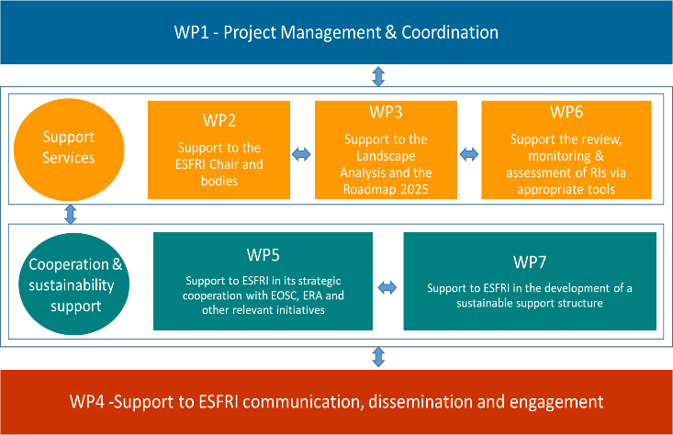
StR-ESFRI3 structure

Slide 19
Landscape Analysis/Roadmap support
Landscape analysis: Support enhanced strategic landscape and gap analyses
RI monitoring: Support the RIs monitoring process and engagement with the MOS
National roadmaps: Support the harmonisation of National Roadmap exercises
ESFRI Roadmap: Support the ESFRI Roadmap process review, implementation and publication of Roadmap

Slide 20
Communication, dissemination & engagement
Vision for StR-ESFRI3
Strategic approach to maximizing ESFRI’s impact
Engagement & Dialogue Platforms
Enhance ESFRI’s visibility
Outreach & Synergies
Openness and transparency
Expand ESFRI visual identity and branding, including key activities
StR-ESFRI2 Vision

